Slide 1
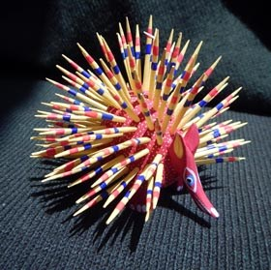
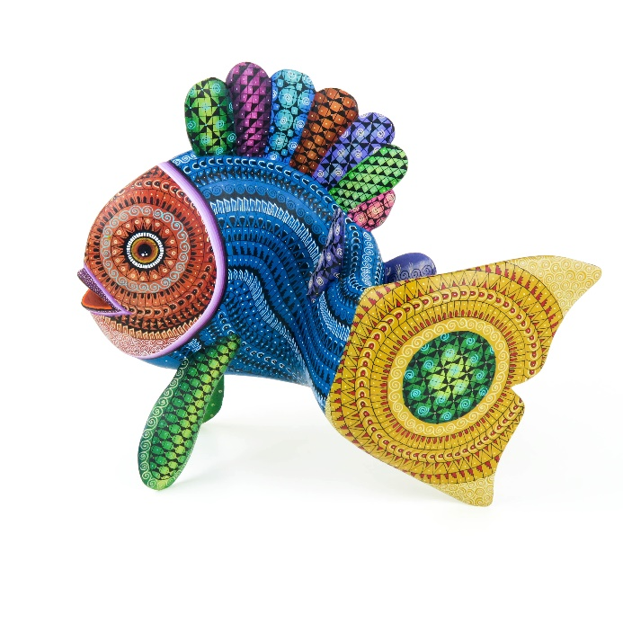
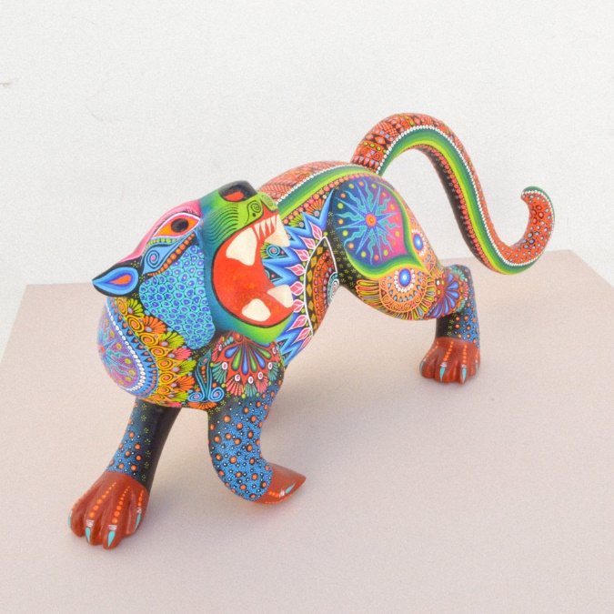
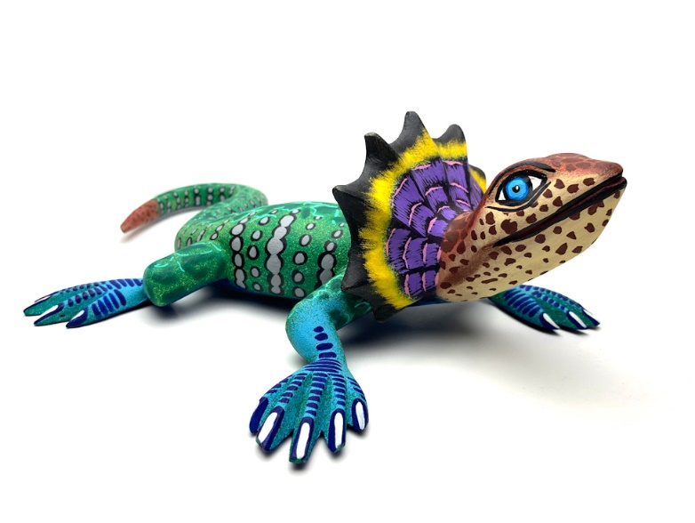
Oaxacan Animals
Kindergarten
Ceramic Owls

Slide 2
Learning Targets and Success Criteria
I can recognize that visual art and design can tell stories. (1.1.a.)
Learn about the Oaxacan culture
I can recognize that individuals will have multiple viewpoints (1.1.b.)
Discuss what was observed in the Oaxacan slide show with peers
I can give an opinion on works of visual art and design (2.1.b.)
Discuss what they liked and did not like about the Oaxacan slide show

Slide 3
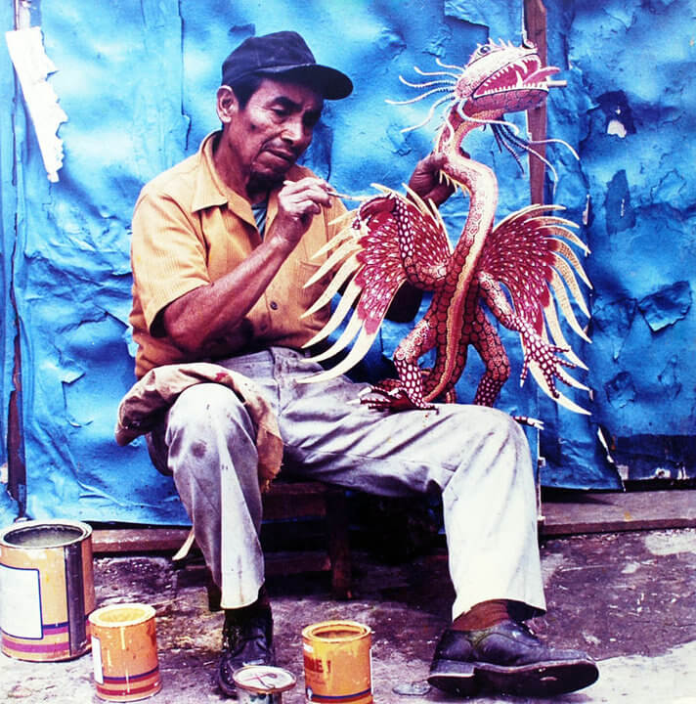
Pedro Linares
In the 1930s, Pedro Linares broke from his tradition of making pinatas and started creating elaborate decorative pieces that represented imaginary creatures he called alebrijes. The alebrije name is often used in reference to the fanciful woodcarvings created by artists in Oaxaca, Mexico.
His paper mache animals gained a lot of attention from art galleries. The idea of Alebrijes became celebrated throughout Mexico and abroad.
Linares returned home to Oaxaca and shared his designs with other artists in his village. Throughout time, different descendents of Linares and others from the village adapted the Alibrejes to this day.

Slide 4
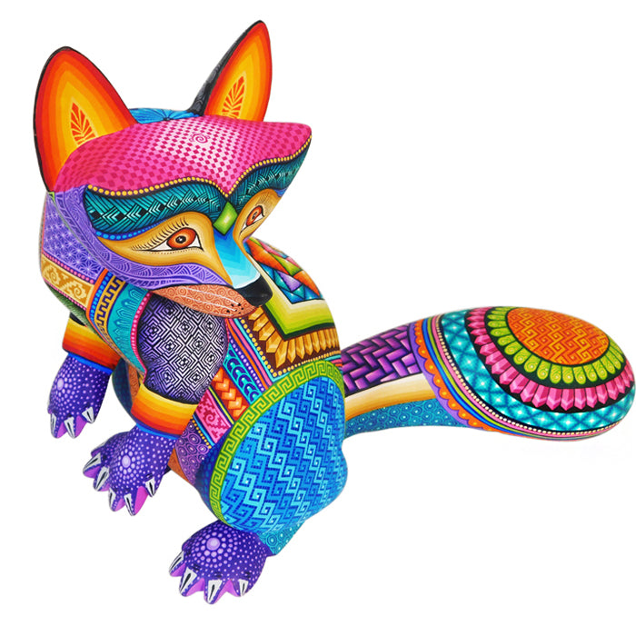
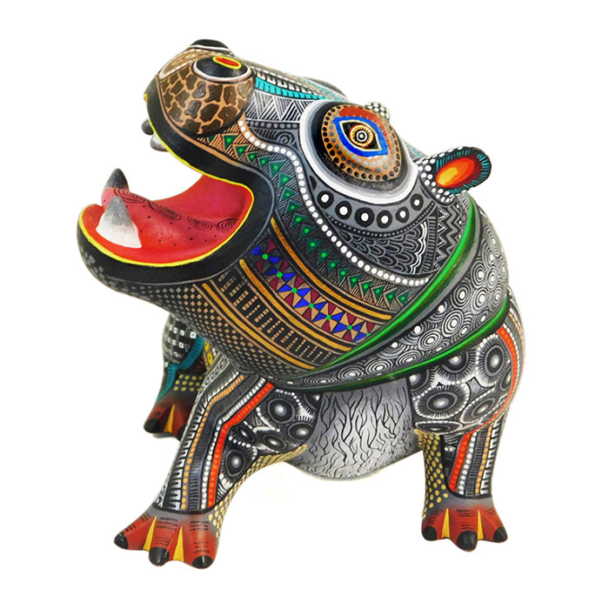

Slide 5
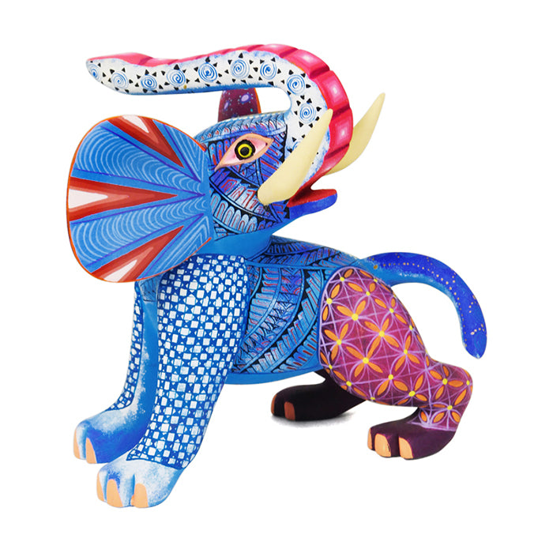
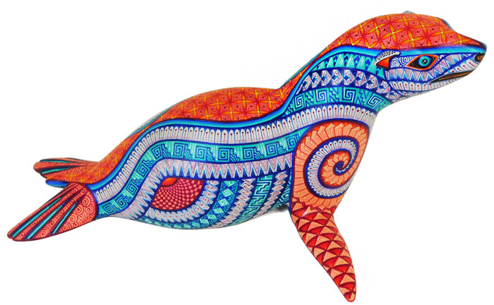

Slide 6
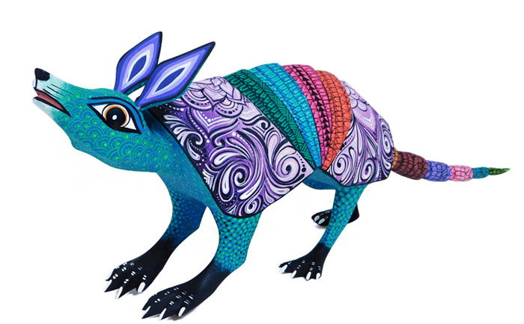
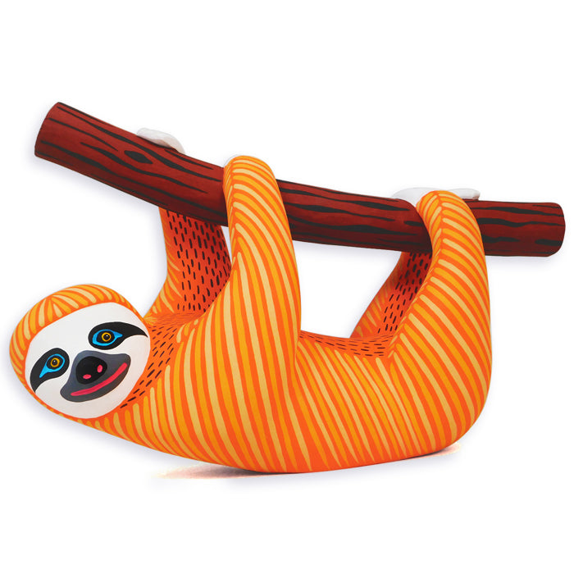
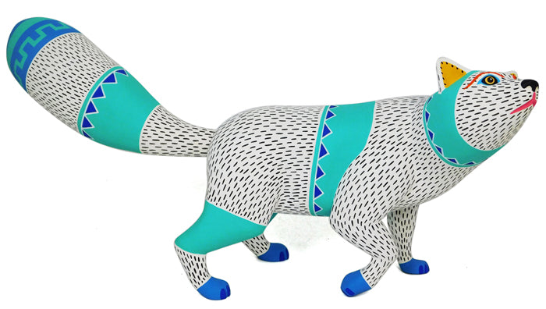

Slide 7
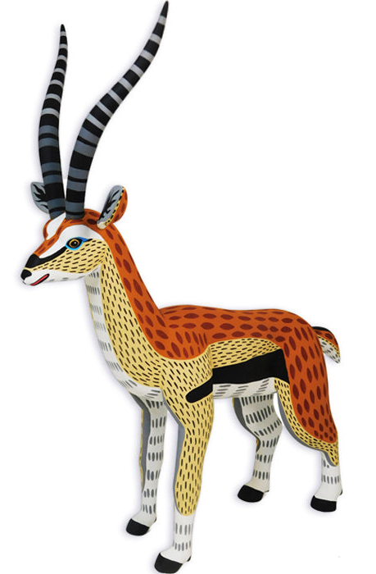
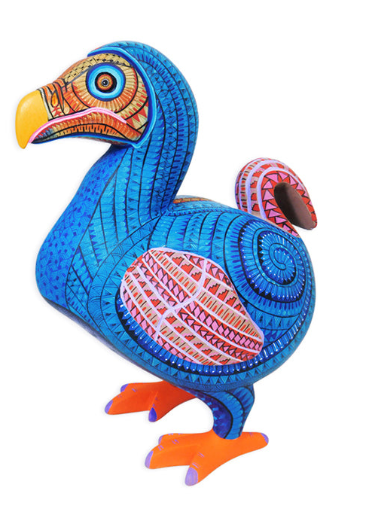
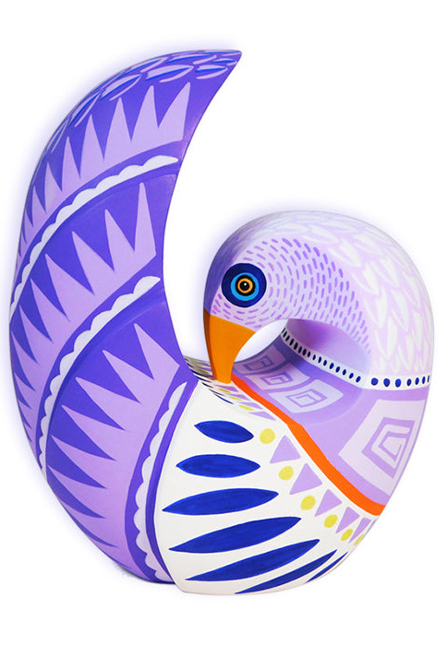

Slide 8
